Slide 1

Speak Fluently & Confidently B1- Course 1

Slide 2
Session 2- Talking about Food
Part 1-: Restaurants (Listening)
Part 2: What would you say in the following
situations? ( Idioms & collocations)
Part 3: Speaking Practice
https://befluent.me/

Slide 3
Session 2-Talking about Food
Part 1-: Restaurants
( Listening )
https://befluent.me/

Slide 4
Lesson 2: Restaurants – Making Reservations & Understanding the Menu
We’re going to eat out – that means eating at a restaurant. This will be a two-part lesson. Today you’ll learn how to make reservations, what to say when you arrive at the restaurant, and how to understand the menu.
Tomorrow you’ll learn how to make orders, interact with the waiter or waitress, pay for the food, and talk about your experience at the restaurant.
Conversation #1 – Making a Reservation
It’s a good idea to call the restaurant and make a reservation in three cases:
First, if you are going to a nice/expensive restaurant.
Second, if you are going to a restaurant that is very popular.
Third, if you are going to the restaurant with a large number of people, and you want to make sure that the restaurant has enough space for everybody.
Restaurant: Angelo’s Restaurant.
John: Hi, I’d like to make a dinner reservation for tomorrow night at 7:30. Restaurant: How many in your party?
John: Six.
Restaurant: Can I get your name and phone number?
John: My name is John Smith, and my number is 203-555-8714
Restaurant: Okay, so I have a reservation for a party of six, under the name “Smith,” tomorrow night at 7:30, is that correct?

Slide 5
John: Yes, that’s right. We’ll also need one high chair and one booster seat.
Restaurant: Not a problem. Is there anything else?
John: No, that’s it, thanks.
Restaurant: All right, Mr. Smith, we’ll see you tomorrow night at 7:30.
Conversation Vocabulary & Phrases
In general, when making a restaurant reservation, you need to give your name, phone number, and the date and time you plan to go to the restaurant.
When the person at the restaurant asks “How many in your party?” she wants to know how many people total will be coming to the restaurant.
If you have any special requests, you can make them – for example, in this conversation, Mr. Smith asks for one high chair and one booster seat. A high chair is a chair for a baby, and a booster seat is a chair for a small child.
While making the reservation, you can also ask for a table in a specific location, for example:
“Can we have a table near the window?”
“Can we have a table on the balcony?”
Conversation #2 – Arriving at the Restaurant
When you enter the restaurant, the person (usually a woman) who greets you is called the hostess. If you made a reservation before arriving, you can say to her:
“I have a 7:30 reservation for John Smith.”
If you didn’t make a reservation, you might need to wait for a table if the restaurant
is crowded (that is, if there are many people in the restaurant):
Hostess: Welcome to Angelo’s – do you have a reservation?
William: No, we don’t.

Slide 6
Hostess: It’s gonna be about a 10-minute wait. Can I get your name?
William: Johnson.
Hostess: OK, and a table for two?
William: Mmm-hmm.
Hostess: All right, you can wait right over there and I’ll let you know when your
table is ready.
Conversation Vocabulary & Phrases
In spoken English, “going to” is often pronounced “gonna,” like when the hostess
says “It’s gonna be about a 10-minute wait.”
The expression “mm-hmm” is a way to say “yes.” English has many different ways to say “yes” and “no” (click here and here for some examples).
Also, if the restaurant has a bar, the hostess may ask if you want to sit at the bar and have a drink while you wait.
If there are tables available when you enter the restaurant, then the hostess will ask you how many people:
Hostess: Good evening. How many?
William: Two.
Hostess: Right this way, please.
(right this way = come with me - you should follow the hostess to the table)
After you sit down, a person will come and ask if you want any drinks. The name of this person is the waiter (if he is a man) or waitress (if she is a woman) –
or server (which can be a man or a woman).

Slide 7
Server: Hi, my name is Sarah and I’ll be your server tonight. How are you doing?
William: Good, thanks.
Server: Here’s the menu. Can I get you anything to drink?
(notice the pronunciation of “Can I get you” – kinIgetcha)
William: Just water for now.
Server: OK, I’ll be back in a few minutes to take your order.
The menu is the list of foods that the restaurant offers, and how much they cost. We use a specific verb for the action of asking for food in a restaurant: to order.
Vocabulary Builder: Understanding the Menu
The menu will often be divided into different sections:
Appetizers or starters are small amounts of food that are eaten before the main dish.
Main dishes or entrees are the biggest and most important parts of the meal, eaten after the appetizers and before dessert. This can also be called the main course.
Specials are specific dishes that are prepared particularly for today, and are often at a reduced price.
Combos is short for combinations - two or more foods that are ordered together as a single item (for example, at McDonald’s you can order a “combo” of a hamburger, French fries, and soda for one price).
Side dishes or sides are small portions of food that can be ordered to accompany the main dishes – for example, you can order a steak with a side of mashed potatoes.
Desserts are sweet foods eaten after the main dish, like ice cream, cakes, pies, etc.
Beverages is another word for drinks. There are also cocktails, which are mixed alcoholic drinks (like margaritas, martinis, and other alcoholic drinks like tequila and rum that are mixed with fruit juices and other ingredients).

Slide 8
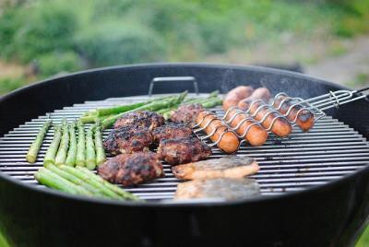
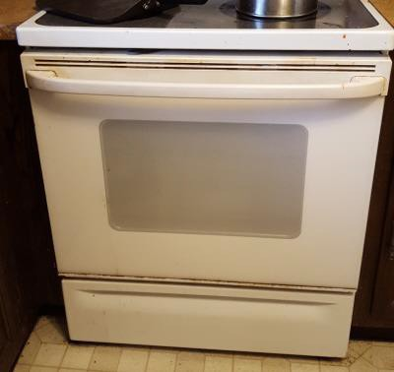
Some menus also categorize the foods by types – for example: sandwiches, soups, salads, seafood (that means animals from the ocean like fish, crab, lobster, etc.), pasta, meat, and poultry (poultry means chicken).
Now let’s learn various ways that food can be prepared.
Food can be grilled or barbecued (cooked on a grill)
Roasted or baked (cooked inside an oven)
Boiled (cooked in water)

Slide 9
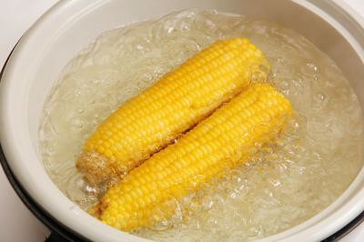
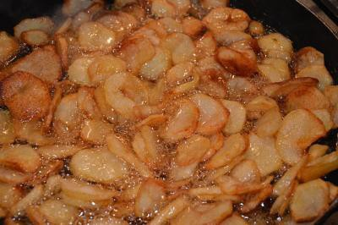
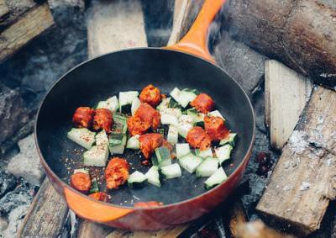
Fried (cooked in oil)
Sautéed (cooked in a very small amount of oil)
Broiled (cooked at high heat for a short time)
Marinated (soaked in liquid to give it more flavor)

Slide 10
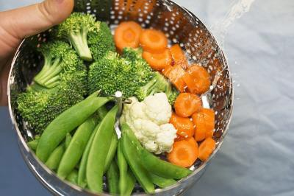
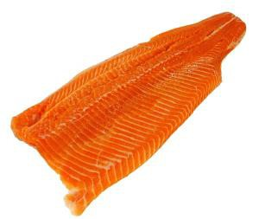
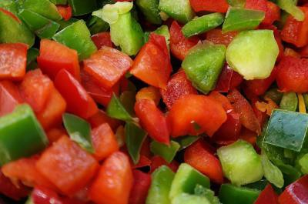
Breaded (covered with bread crumbs and cooked)
Steamed (cooked with water vapor)
Steamed vegetables are not cooked IN the water. They are cooked ABOVE the water.
Sometimes, the food is also described by its appearance:
A thin cut of meat or fish is called a fillet (the “t” in fillet is silent).
Vegetables can be chopped (cut into squares):

Slide 11
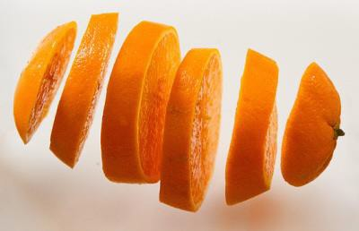
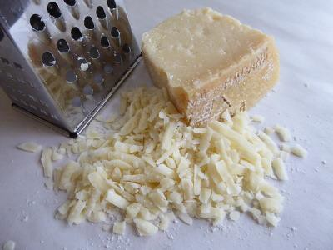
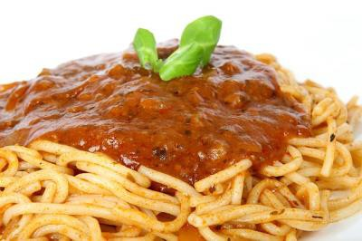
or sliced (cut into thin pieces):
Cheese can be grated (scraped into small pieces):
Also, food can be covered with or topped with a liquid, which is called sauce or dressing.
With meat and pasta, we use the word sauce.
With salads, we use the word dressing:

Slide 12
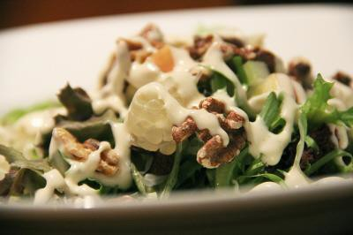
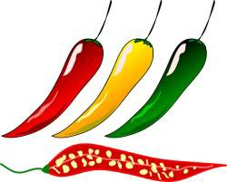
For some more advanced restaurant menu vocabulary, click on these two example menus: American Diner Menu and British Restaurant Menu.
Asking questions about the menu
Here are some typical questions you can ask the server in order to find out more information about the dishes on the menu:
“Is that a big portion?”
(portion = quantity of food)
“Is it spicy?”
(ask this to find out if the food has “hot” peppers)
“Does it have any peanuts in it? I’m allergic.”
(allergic = your body has a bad reaction)
“Do you have any diet / light dishes?”
(some restaurants have a “light” section of the menu, with foods that are healthy and low-fat, but you can also ask the server which dishes are good for a person on a diet)
“Do you have any vegetarian dishes?”
(ask the server this question if you don’t eat meat)

Slide 13
“Does that come with any sides?”
(sometimes, the entrees come with side dishes like potatoes, vegetables, salads, or soups, which are included in the price of the main dish)
“Can I substitute a salad for the soup?” “Can I have a salad instead of the soup?”
(ask one of these questions to find out if it’s possible to exchange one item for
another)
“Do you have a kids’ menu?”
(many servers will give you a kids’ menu automatically if they see you have
children, but you can also request it)
“What are today’s specials?”
(many restaurants have dishes that are prepared especially for that day, and some have a reduced price)
“What do you recommend?”
(if you really don’t know what to order, you can ask the server for a suggestion. Often, he or she will recommend a popular dish that the restaurant is especially known for)

Slide 14
Quiz – Lesson 2
We'd prefer a table the window.
close
near
next
What are today's ?
menus
reserves
specials
Does that with any sides?
go
come
bring
What kind of salad do you have?
coverings
dressings
toppings
I have an 8:00 for a party of four.
appointment
order
reservation
Is that a big ?

Slide 15
plate
portion
special
I can't eat oysters - I'm to shellfish.
allergic
reactive
sick
The lamb chops are in red wine; they're really delicious!
boiled
marinated
steamed
Can I have vegetables the French fries?
instead of
because of
exchange for
The chicken is a low-fat option.
baked
grated
fried
Do you have a kids' ?
appetizer
menu
waiter
I'll be back in a few minutes to take your .
A. combo B. dish C. order

Slide 16
Lesson 2 Quiz - Answers
1.B 2.C 3.B 4.B 5.C 6.B 7.A 8.B 9.A 10.A 11.B 12.C

Slide 17
Session 2- Talking about Food
Part 2: What would you say in the following
situations? ( Idioms & collocations)
https://befluent.me/

Slide 18
Session 2- Talking about Food
The Apple Of One’s Eye
When someone has a favourite person (for example, a child or grandchild) who they are very proud of and always happy to see, we refer to this person as the apple of one’s eye.
Example:
The grandfather had four grandchildren. Two boys and two girls. He was fond of all of them but the first born grandchild was his favourite and he always told her (Mary) that she was the apple of his eye.
Spill The Beans
Meaning: to reveal a secret or confess to something
Example:
Don’t tell her, because she’ll spill the beans to everybody.
Beans are a favourite food of many. Easy to make. Tasty to eat and cheap to buy.
However, if you drop them or spill them it can be a little bit messy (tomato sauce everywhere!)
So when someone has a secret or some information that we really want we keep asking them to tell us. We ask them to “spill the beans” or give us the information.
We constantly urge them (encourage them):
Come on, spill the beans, you know you want to!
https://befluent.me/

Slide 19
Session 2- Talking about Food
Full Of Beans
Still on the theme of beans. Lots of food is well known for giving us energy. Beans in particular offer one of the best sources of energy.
If someone is full of beans, it means they are full of energy, they are very active.
Example:
When children are jumping and running and screaming and shouting we often hear the parents saying: “Don’t worry, they are full of beans”.
To Butter Somebody Up
Sometimes it is difficult to persuade someone to do what you want them to or to get them to agree to your request.
To help we often have to find their “good side” (something that will help in persuading him/her more easily).
Often praising them or flattering them works quite easily and we refer to this as buttering them up (like putting lots of butter on toast; it makes the toast very smooth).
Example:
Juan wanted Ana to cook his favourite meal (paella). Ana said she was busy and did not have the time. Juan told her over and over again that she was a great cook and her paella was well known to be the best in the family. “Come on, you know your paella is the best. Let’s have a beautiful evening paella, wine and music”. He continued this for several minutes until she eventually agreed. His buttering up had worked. He got his paella.
https://befluent.me/

Slide 20
Session 2- Talking about Food
Part 3: Speaking Practice
https://befluent.me/

Slide 21
Session 2- Talking about Food
What comes to mind when you hear the word ‘restaurant’?
2) What is your favorite restaurant and why?
3) Do you like expensive restaurants?
4) How often do you go to restaurants?
5) Do you think the ambience is important in restaurants?
6) What kind of restaurant would you like to open?
7) What’s the best restaurant name you’ve heard of?
8) Are you happy with the restaurants in your town?
9) Is restaurant food the best?
10) Have you ever complained about the food or service in a restaurant?
https://befluent.me/

Slide 22
Session 2- Talking about Food
If you could have your own restaurant, what would you call it?
2) What do you think of fast food restaurants?
3) Would you go to a romantic restaurant with a friend?
4) What do you think people study on a restaurant management course?
5) Do you prefer restaurants that are cheap and cheerful or very fancy?
6) Do you think you should tip the staff in restaurants?
7) Would you like to work as a restaurant critic?
8) What’s the longest you’d wait for a restaurant table?
9) What’s the most expensive meal you’ve had at a restaurant?
10) Would you like to eat at a different restaurant every night for the rest
of your life?
https://befluent.me/

Slide 23
Session 2- Talking about Food
Thank you!☺
https://befluent.me/

